Slide 1
Modeling scenarios in DAX, the awesome language of Power BI

Slide 2











Slide 4
Session Agenda
Intro
Decisions to take
Filters, business logic & DAX
Solving time intelligence requirements
DAX for improving reports

Slide 5
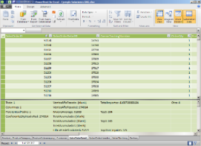
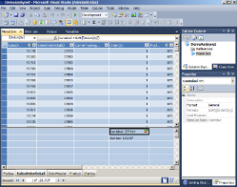
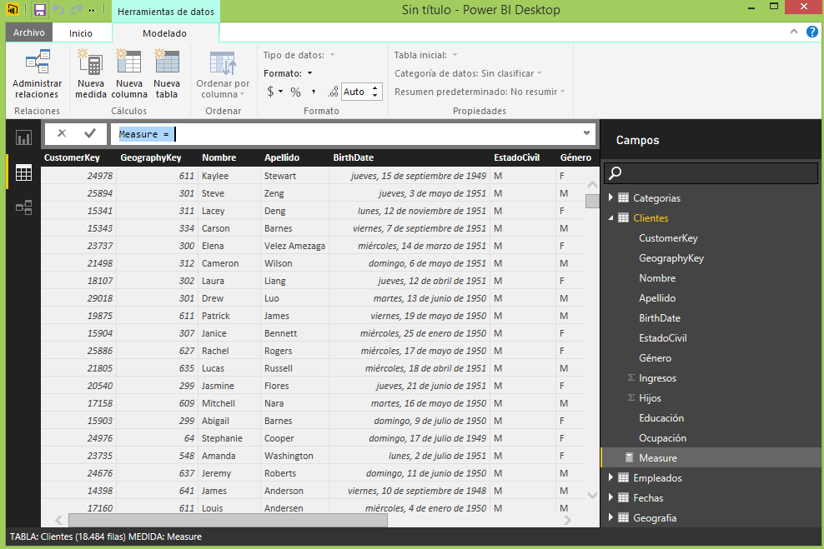
DAX - Introduction
DAX – Data Analysis Expressions
Tabular models
Power Pivot
SQL Server Analysis Services Tabular
Power BI

Slide 6
DAX - Introduction
DAX – Data Analysis Expressions
Analytical engine for tabular models
Leverage existing knowledge of Excel formulas
Function built to work with relational data
Queries data models
Creates calculated columns, measures and calculated tables
Functional language
Execution flows as function calls
From inner to outer most
Single line execution, admit text formatting
Syntaxis is intuitive

Slide 7
Decisions to take !!

Slide 8
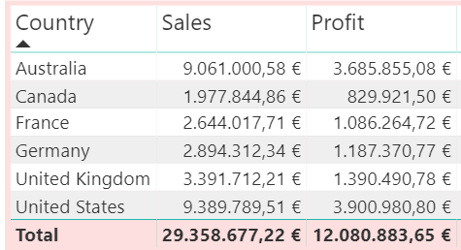
Decisions to take
Calculated columns vs measures?

Slide 9
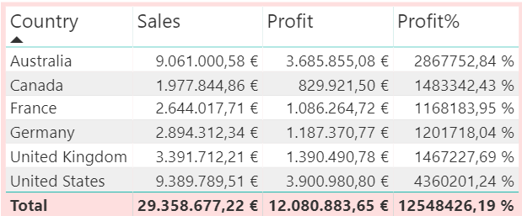
Decisions to take
Calculated columns vs measures?

Slide 10
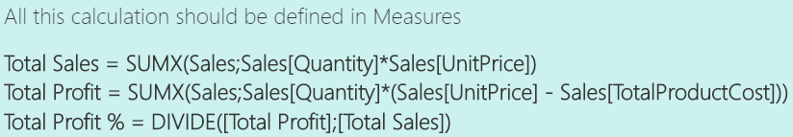
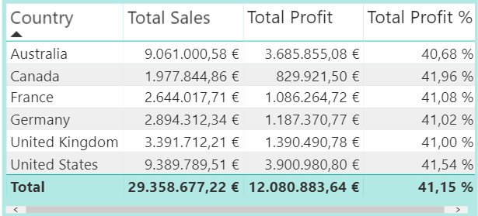
Decisions to take
Measures !! ☺

Slide 11
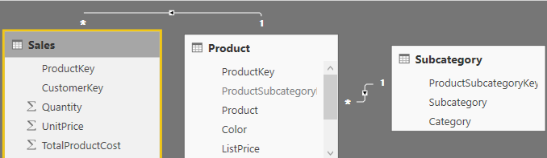
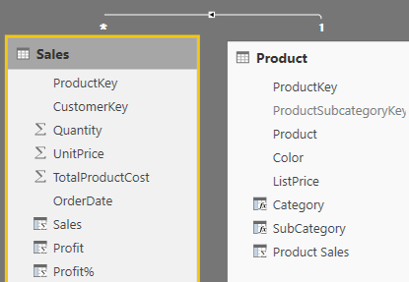
Decisions to take about tabular modeling
Unique table
Snowflake
Star

Slide 12
Decisions to take
Unique table
Excel classic, before Excel 2013
Snowflake
Normalized
There are links between the search tables
or directly to the facts tables
Star
De-normalized model
All search tables (dimensions)
point directly to the facts table

Slide 13
Filters, business logic & DAX

Slide 14
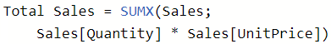
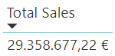
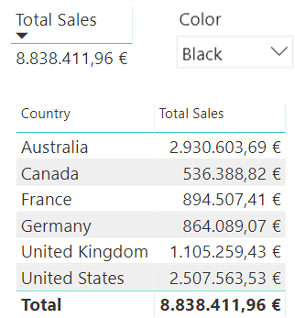
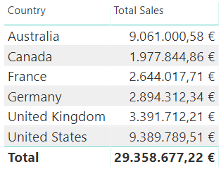
DAX filters and DAX contexts
Different results of a measure, depending on filters
The result depends on:
The code
The filters

Slide 15
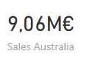
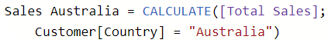
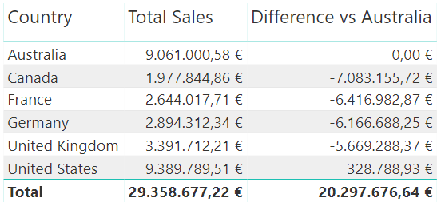
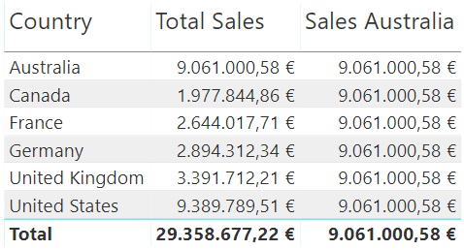
Creating business logic with DAX
Contexts and comparisons
Compare in a single category

Slide 16
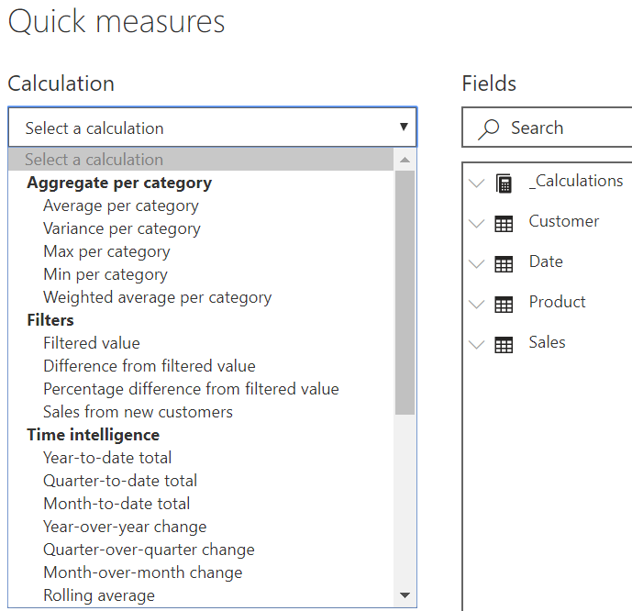
Creating business logic with DAX
Quick measures
For speeding writing calculation
For learning DAX ☺

Slide 17
Creating business logic with DAX
Replace the existing filter context
With functions CALCULATE or CALCULATETABLE

Slide 18
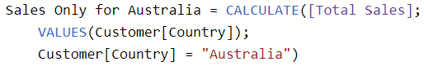
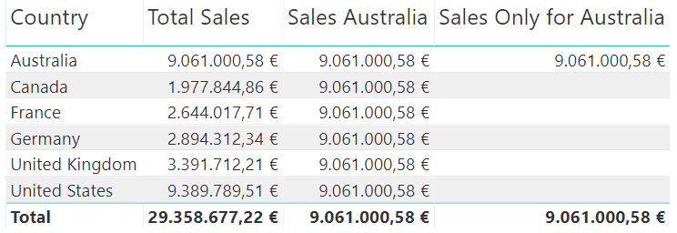
Creating business logic with DAX
Retrieve existing context
Function VALUES

Slide 19
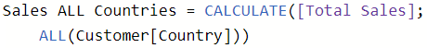
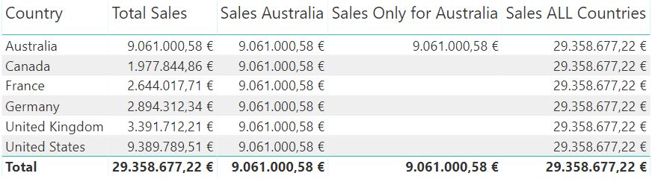
Creating business logic with DAX
Ignore existing context
Function ALL

Slide 20
Creating business logic with DAX
What about Total line?

Slide 21
Creating business logic with DAX
What about Total line?

Slide 22
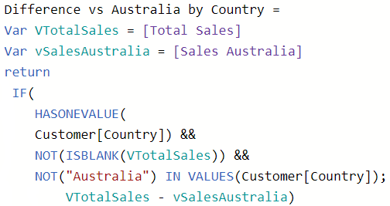
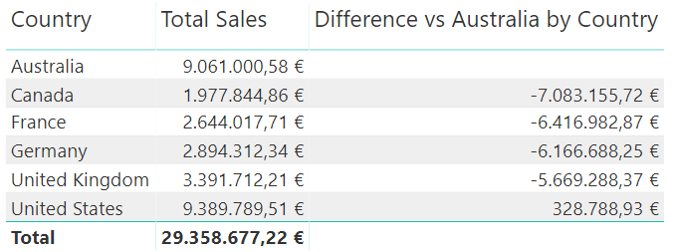
Creating business logic with DAX
Calculating totals
Exclude total value

Slide 23
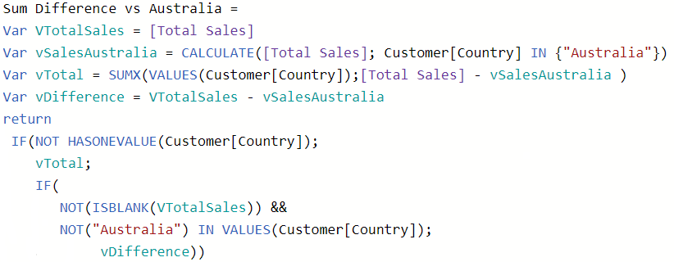
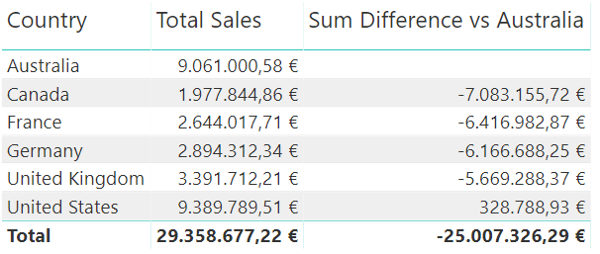
Creating business logic with DAX
Calculating totals
Obtain total value by adding the difference

Slide 24
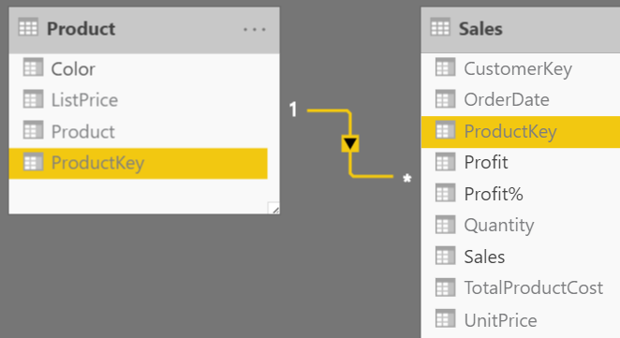
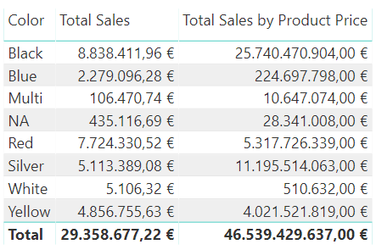
Creating business logic
Combining related tables in DAX expressions

Slide 25
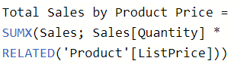
Creating business logic
DAX, DAX, DAX, again, one more time DAX

Slide 26
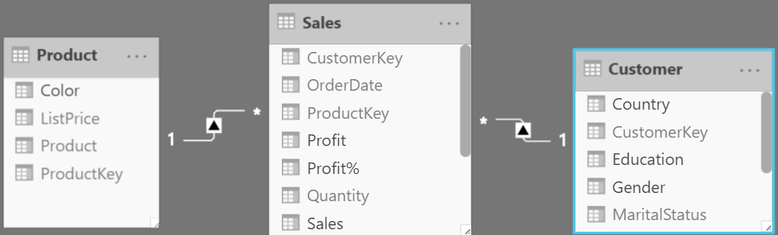
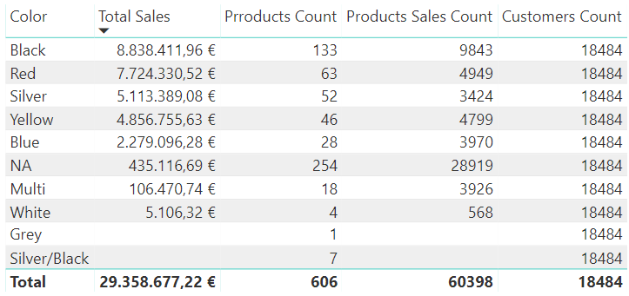
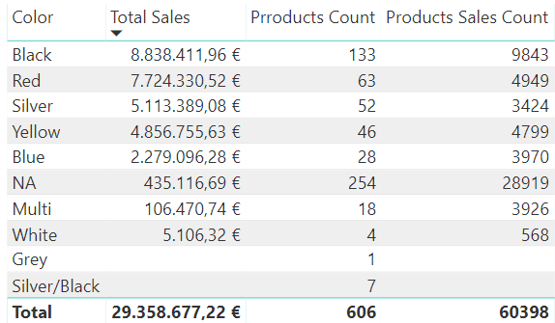
Creating business logic
Crossfilter direction

Slide 27
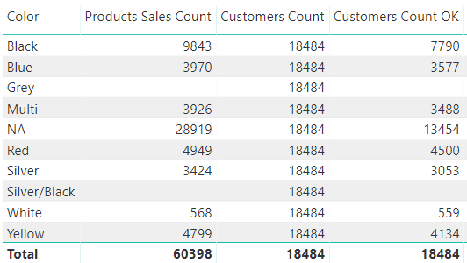
Creating business logic
And…one more time, DAXing solution ☺

Slide 28
Solving time intelligence requirements

Slide 29
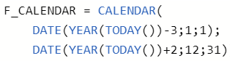
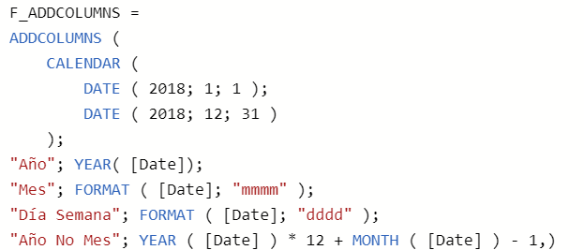
Calendar table with DAX
Calendar table
Calendar table defining boundaries
Calendar table plus columns

Slide 30
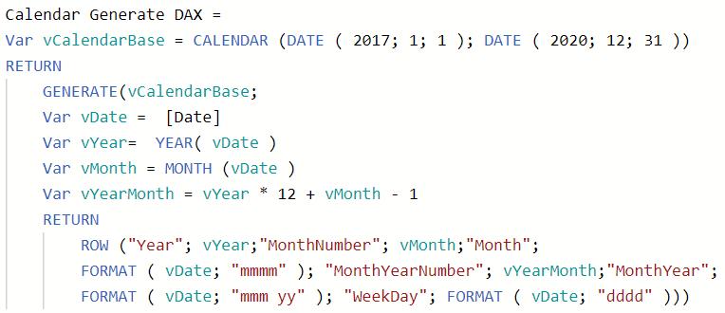
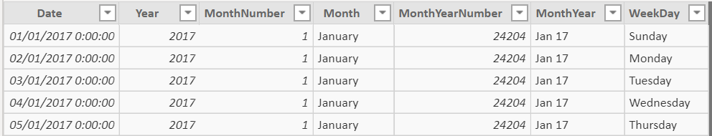
Calendar table with DAX
Calendar table plus columns

Slide 31

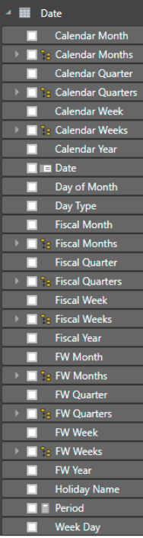
Calendar table with DAX
DAX Calendar template from SQLBI
https://www.sqlbi.com/articles/reference-date-table-in-dax-and-power-bi/

Slide 32
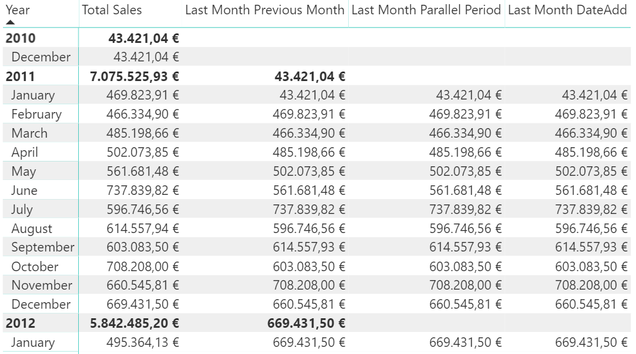
Solving time intelligence requirements
Comparison
BI DAX functions, variables and CALCULATE

Slide 33
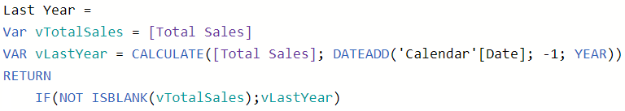
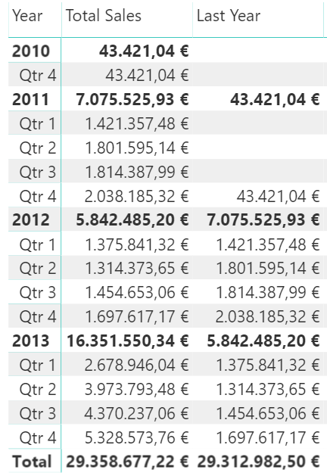
Solving time intelligence requirements
Comparison
BI DAX functions, variables and CALCULATE

Slide 34
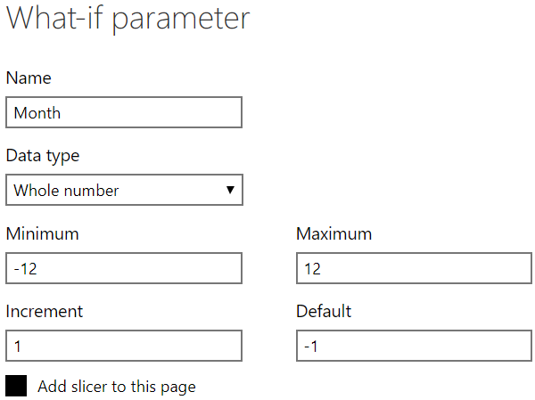
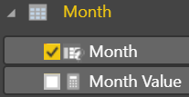
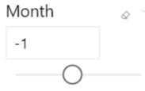
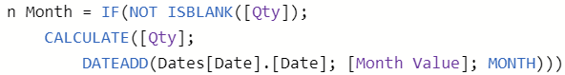
Solving time intelligence requirements
What if functionality ☺

Slide 35
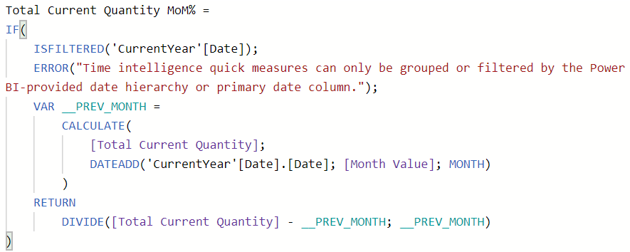
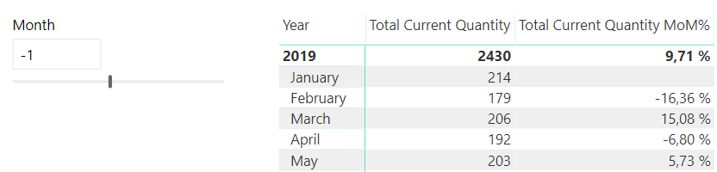
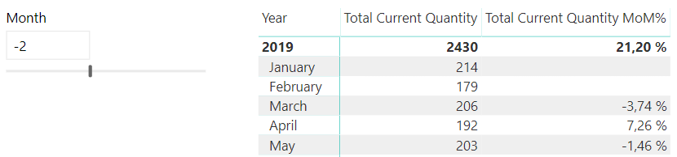
Solving time intelligence requirements
DAX to rescue … again -> What if & Quick measure

Slide 36
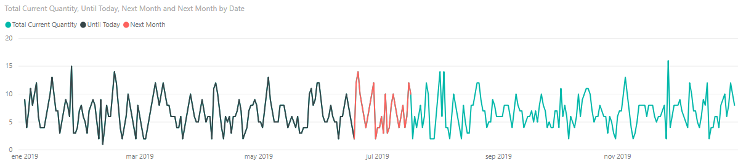
Solving time intelligence requirements
Dynamic ranges
BI DAX functions, variables and CALCULATE

Slide 37
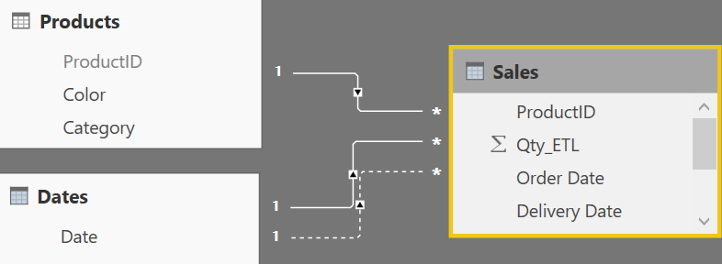


Data modeling, working with dates and DAX
Multiple relationships, only one active
Function USERELATIONSHIP

Slide 38



Data modeling, working with dates and DAX
Multiple calendar tables
Create a new table

Slide 39
DAX for improving reports

Slide 40





DAX for improving visualizations
Dynamic selection of measures

Slide 41

DAX for improving visualizations
Showing alerts
(Quick Measures Gallery - Power BI Community)
https://community.powerbi.com/t5/Quick-Measures-Gallery/bd-p/QuickMeasuresGallery

Slide 42


DAX for improving visualizations
Showing rating
(Quick Measures Gallery - Power BI Community)
https://community.powerbi.com/t5/Quick-Measures-Gallery/bd-p/QuickMeasuresGallery
https://www.havensconsulting.net/blog-and-media
https://exceleratorbi.com.au/dax-unichar-function-power-bi/
https://blog.crossjoin.co.uk/2017/04/11/the-dax-unichar-function-and-how-to-use-it-in-measures-for-data-visualisation/

Slide 43
DAX - Recap
It is easy to start writing DAX expressions for tabular models
Very powerful, and delicate at the same time
Measures and CALCULATE are our best allies
#HappyDAXing ☺
Thank you !!!

Slide 44

Session Feedback Day 2 (not optional!)
http://bit.ly/DataGrillen2019Day2

Slide 45

Event Feedback (not optional!)
http://bit.ly/DataGrillen2019Event

Slide 46
Thank you ☺

Slide 47

Free courses
https://www.sqlbi.com/training/

Slide 48


Resources
Books
The Definitive Guide to DAX
Analyzing Data with Power Bi and Power Pivot for Excel

Slide 49

Resources
Books
Exam Ref 70-778 Analyzing and Visualizing Data by Using Microsoft Power BI

Slide 50


Resources
Books
Mastering Microsoft Power BI
Microsoft Power BI Cookbook

Slide 51

Resources
Books
DAX Patterns

Slide 52
Resources
Blogs
SQLBI, con Marco Russo y Alberto Ferrari
Patrones DAX desde SQLBI
Power Pivot Pro
Chris Webb’s BI Blog
Reza Rad, Leila Etaati & Philip Seamark
Kasper On BI
Matt Allington
Data and Analytics with Dustin Ryan
Teo Lachev – Prologika

Slide 53
Resources
Blogs
Roger Torné (en español)
Pragmatic Works
Brett Powell
Gilbert Quevauvilliers
Sam McKay DAX Modelado
Imke Feldmann
Daniil Maslyuk
Melissa Coates
Serie sobre DAX y PowerBI en SQLServerCentral

Slide 54
Resources
Articles and blog’s entries
https://insightsquest.com/2018/05/27/data-model-anti-patterns/
https://exceleratorbi.com.au/what-is-dax/
https://powerpivotpro.com/2018/08/dax-back-to-the-basics/
https://community.powerbi.com/t5/Quick-Measures-Gallery/bd-p/QuickMeasuresGallery
https://exceleratorbi.com.au/using-variables-dax/
https://www.sqlbi.com/blog/marco/2017/09/12/the-easiest-way-to-start-using-variables-in-dax/
https://www.sqlbi.com/articles/optimizing-if-conditions-using-variables

Slide 55
Resources
Articles and blog’s entries
https://www.sqlbi.com/articles/reference-date-table-in-dax-and-power-bi/
https://www.mssqltips.com/sqlservertip/4857/creating-a-date-dimension-table-in-power-bi/
https://powerpivotpro.com/2014/04/week-ending-date-calculation/
https://powerpivotpro.com/2013/06/simplifying-time-calculations-and-the-user-experience-using-disconnected-slicers/

